Slide 1
Bioinformatics
LUSC Gene Expression Analysis
Analysis of Gene Expression Data for Lung Squamous Cell Carcinoma (LUSC)

Slide 2
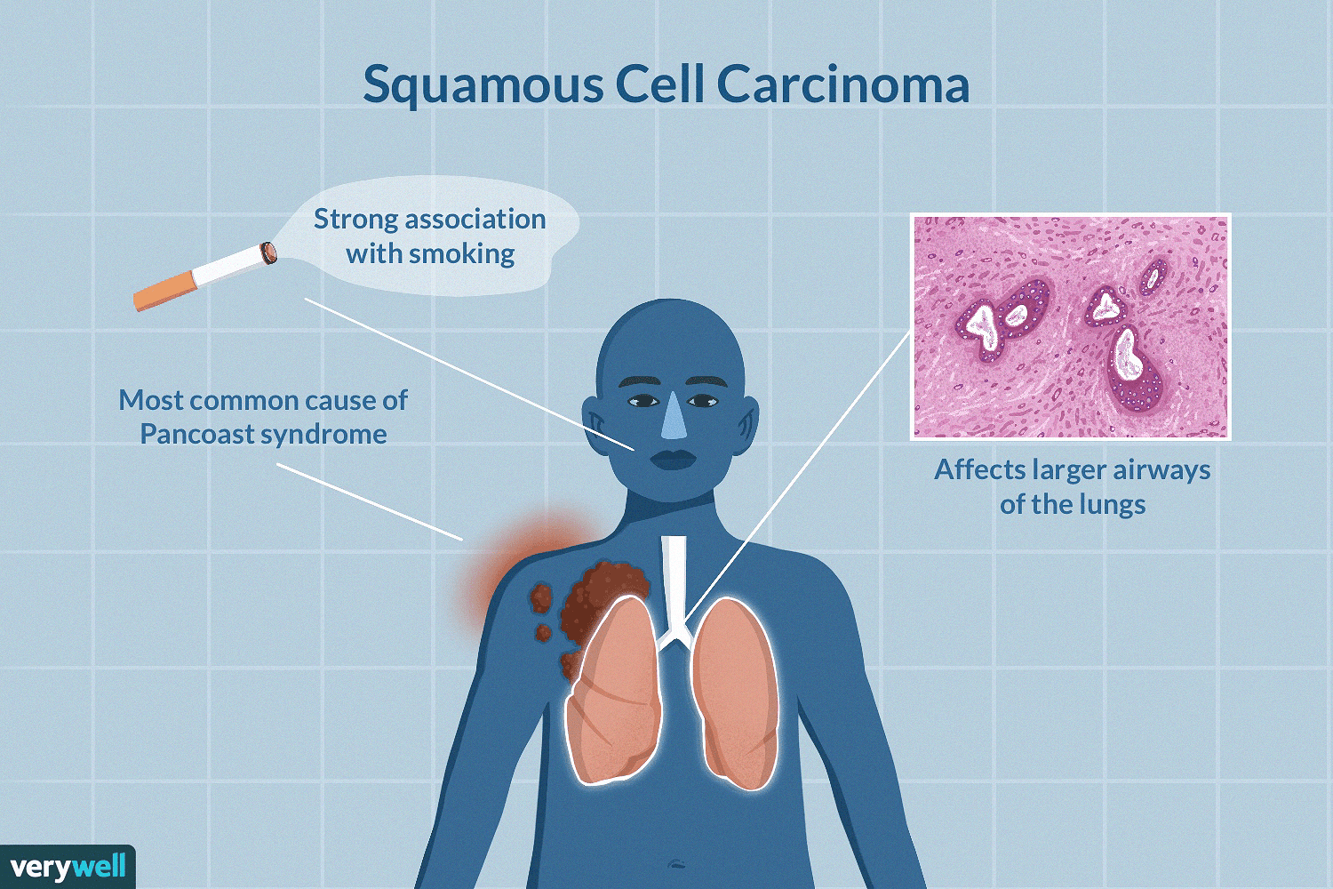
Introduction
Studying the gene expression (GE) data of Lung Squamous Cell Carcinoma (LUSC) provides insights into the biological processes and potential therapeutic targets associated with the disease.
An Overview of Squamous Cell Carcinoma in the Lungs
https://www.verywellhealth.com/squamous-cell-carcinoma-of-the-lungs-in-depth-2249367

Slide 3
Objectives
01
03
02
04
Identify DEGs using hypothesis testing and fold change methods.
Visualize DEGs using a volcano plot.
Compare the DEGs across paired and independent sample scenarios.
Conduct GSEA on the DEGs obtained from the paired samples hypothesis.

Slide 4
Methodology: Preprocessing
Genes with more than 50% zero expression values were removed
To account for differences in sequencing depth and other technical variations
Filtering Genes
Normalization
01
02
03
04
Data Loading
Handling Missing Values
For both healthy and tumor tissues were loaded into pandas dataframes
Any remaining missing values were dropped

Slide 5
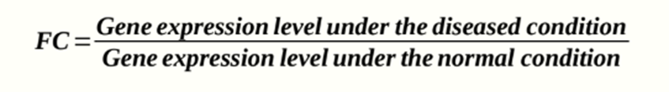
Methodology
Identifying DEGs
Fold Change
Hypothesis Testing
Wilcoxon Signed-Rank Test
Mann-Whitney U Test
The equation from Lecture 09: Microarray Data Analysis
For Paired Samples
For Independent Samples

Slide 6
Volcano Plot
Hypothesis Testing
To quickly identify changes in large datasets composed of replicate data.
Enables to efficiently identify genes of interest by simultaneously evaluating both their statistical significance and the magnitude of their expression changes
03
Volcano Plot
Fold Change

Slide 7
Gene Set Enrichment Analysis (GSEA)
Input
Gene Sets
Predefined collections of genes
A ranked list of genes based on their differential expression (e.g., from the volcano plot analysis).
Tool
GSEApy package (Python)
Enrichment Score
GSEA calculates an enrichment score for each gene set, reflecting the degree to which the genes in the set are overrepresented at the top or bottom of the ranked list.

Slide 8
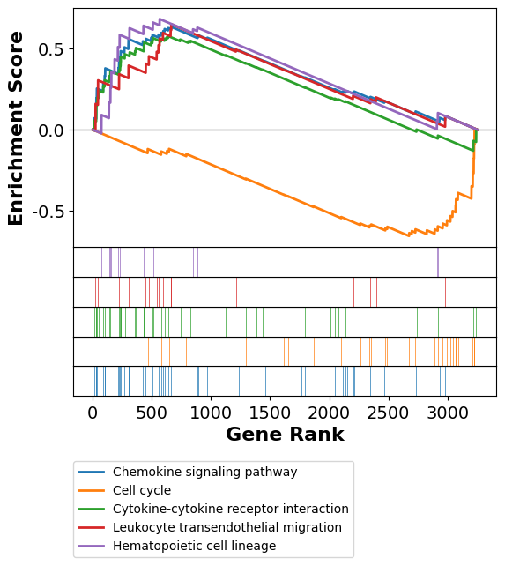
Gene Set Enrichment Analysis (GSEA)
“The method derives its power by focusing on gene sets, that is, groups of genes that share common biological function, chromosomal location, or regulation.”
Subramanian et al, “Gene set enrichment analysis: A knowledge-based approach for interpreting genome-wide expression profiles,” PNAS, 102 (43), 15545-15550, 2005.

Slide 9
Results
DEGs Identification
Volcano Plot
GSEA

Slide 10
DEGs: Hypothesis Testing
Gene Name | p value - Paired | p value - Independent
RAB37 | 8.240413e-17 | 1.776357e-15
TMSB15B | 0.000489 | 0.009540
NOXRED1 | 0.496389 | 0.178853
FAM26F | 0.923781 | 0.462832
MRPL46 | 1.000000 | 0.849638
3253 - Paired 3199- Independent

Slide 11
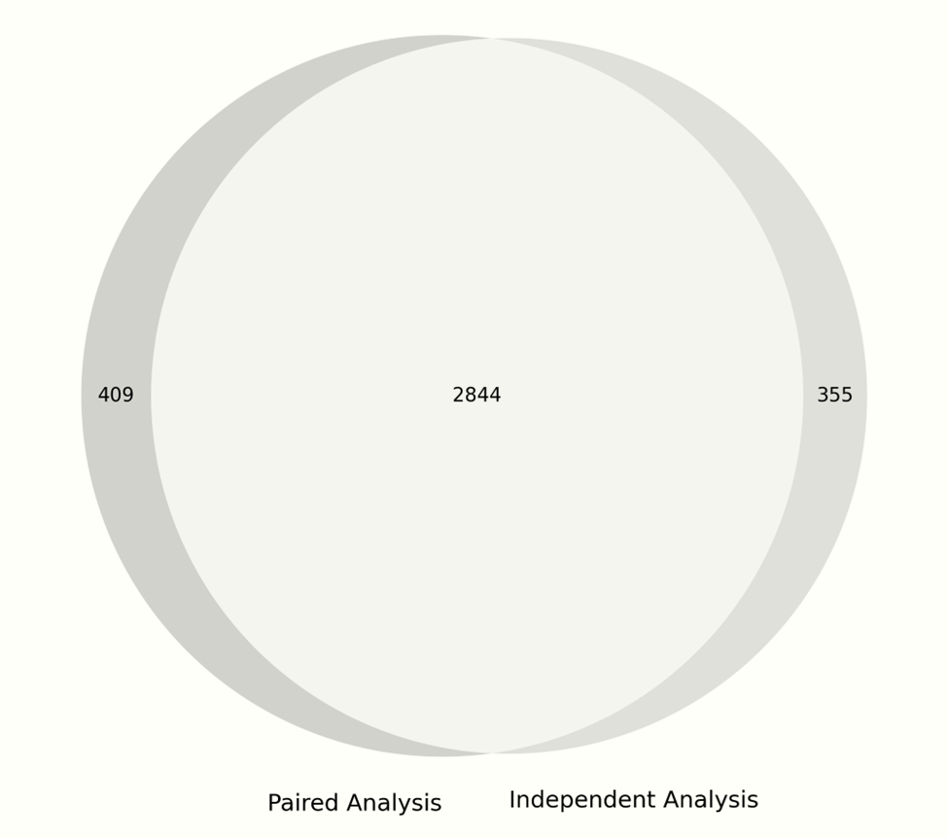
Paired vs Independent
355
Comparison of DEGs
Total Unique DEGs: 3608
Overlap: 2844 genes
Paired-only: 409 genes
Independent-only: 355 genes
409
2844

Slide 12
DEGs: Fold Change
Gene Name | Fold Change | Log2 FC | Abs Log2 FC
KRT14 | 0.0030094451828 | -8.376286746 | 8.3762867464118
KCNMB3 | 0.454168231810121 | -1.1387012990 | 1.13870129904265
PDE4A | 2.20175347967001 | 1.1386529459 | 1.1386529459380
TOPORS | 1.087924118516128 | 0.12157793374 | 0.12157793374061
APLNR | 2.835698288558 | 1.5037040414 | 1.5037040414788
Note 1
Note 2

Slide 13
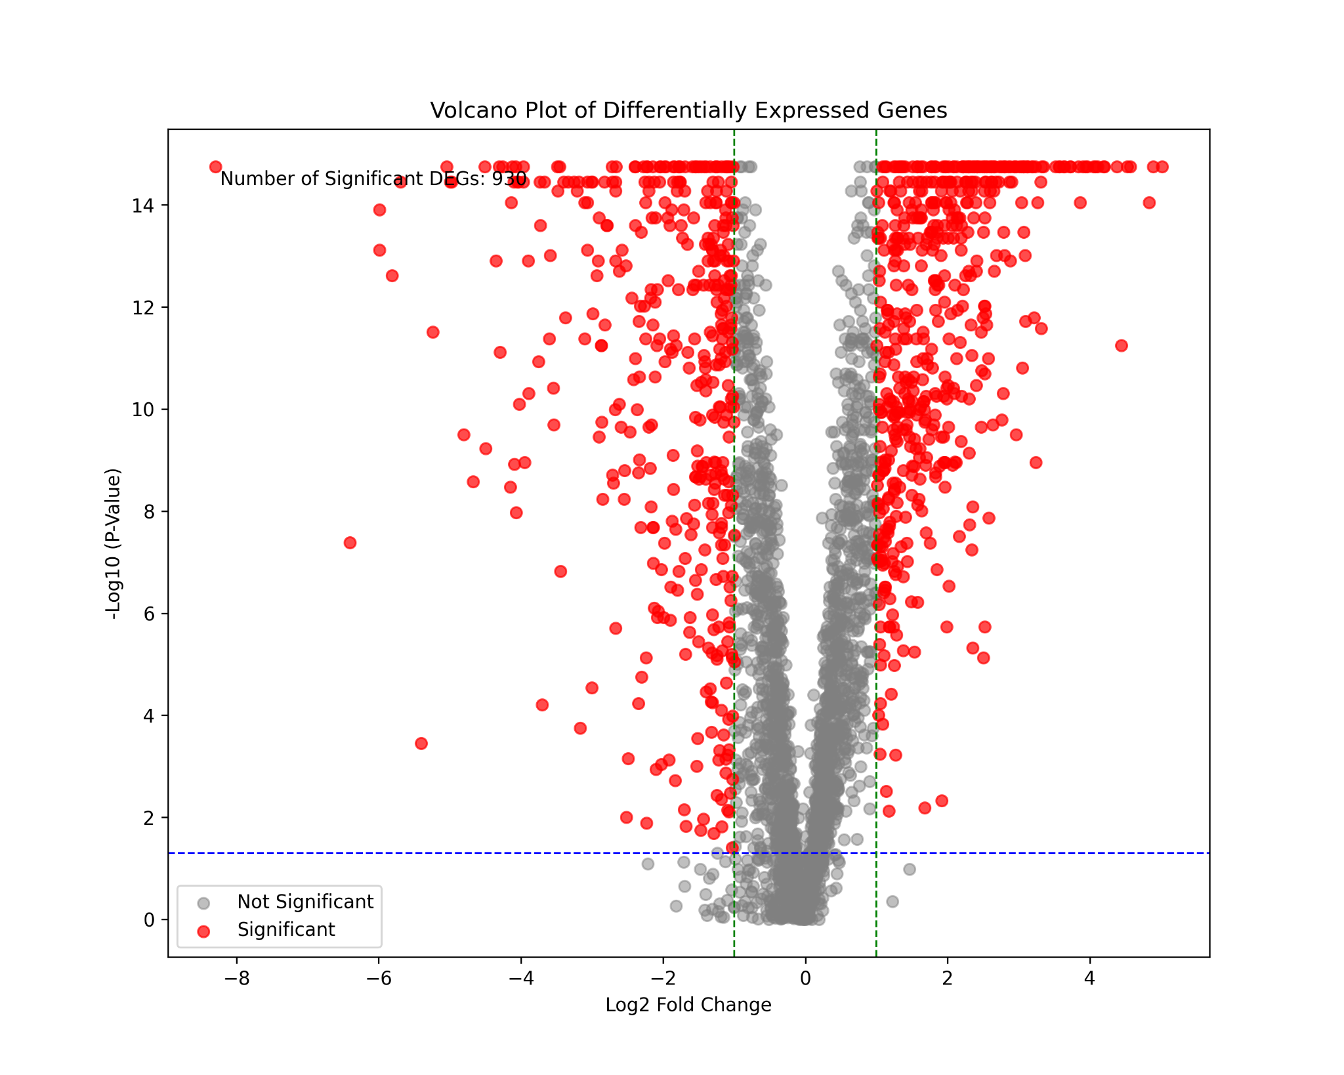
DEGs: Volcano Plot

Slide 14
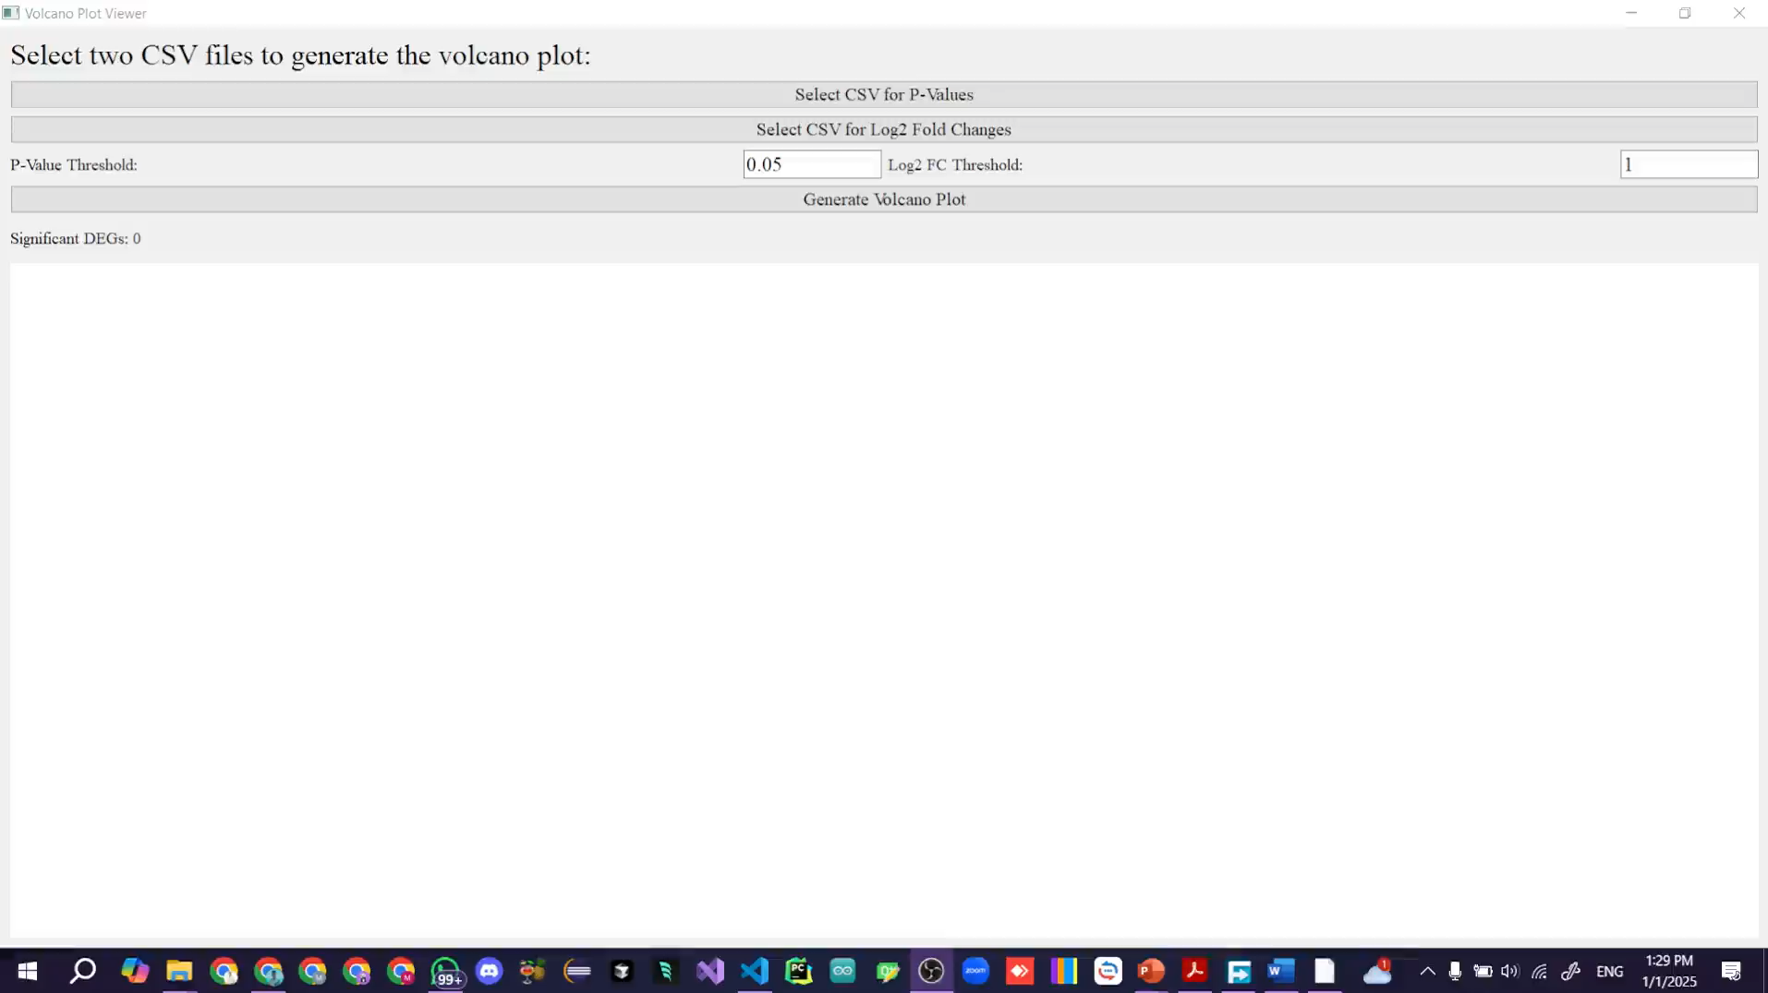
PyQT Application to display Volcano plots
Allow the user to load datasets from his device
Real-time plotting and label for each Gene with gene name, p-value, log (FC), and significant level.
Real-time threshold change

Slide 15
Gene Set Enrichment Analysis (GSEA)

Slide 16
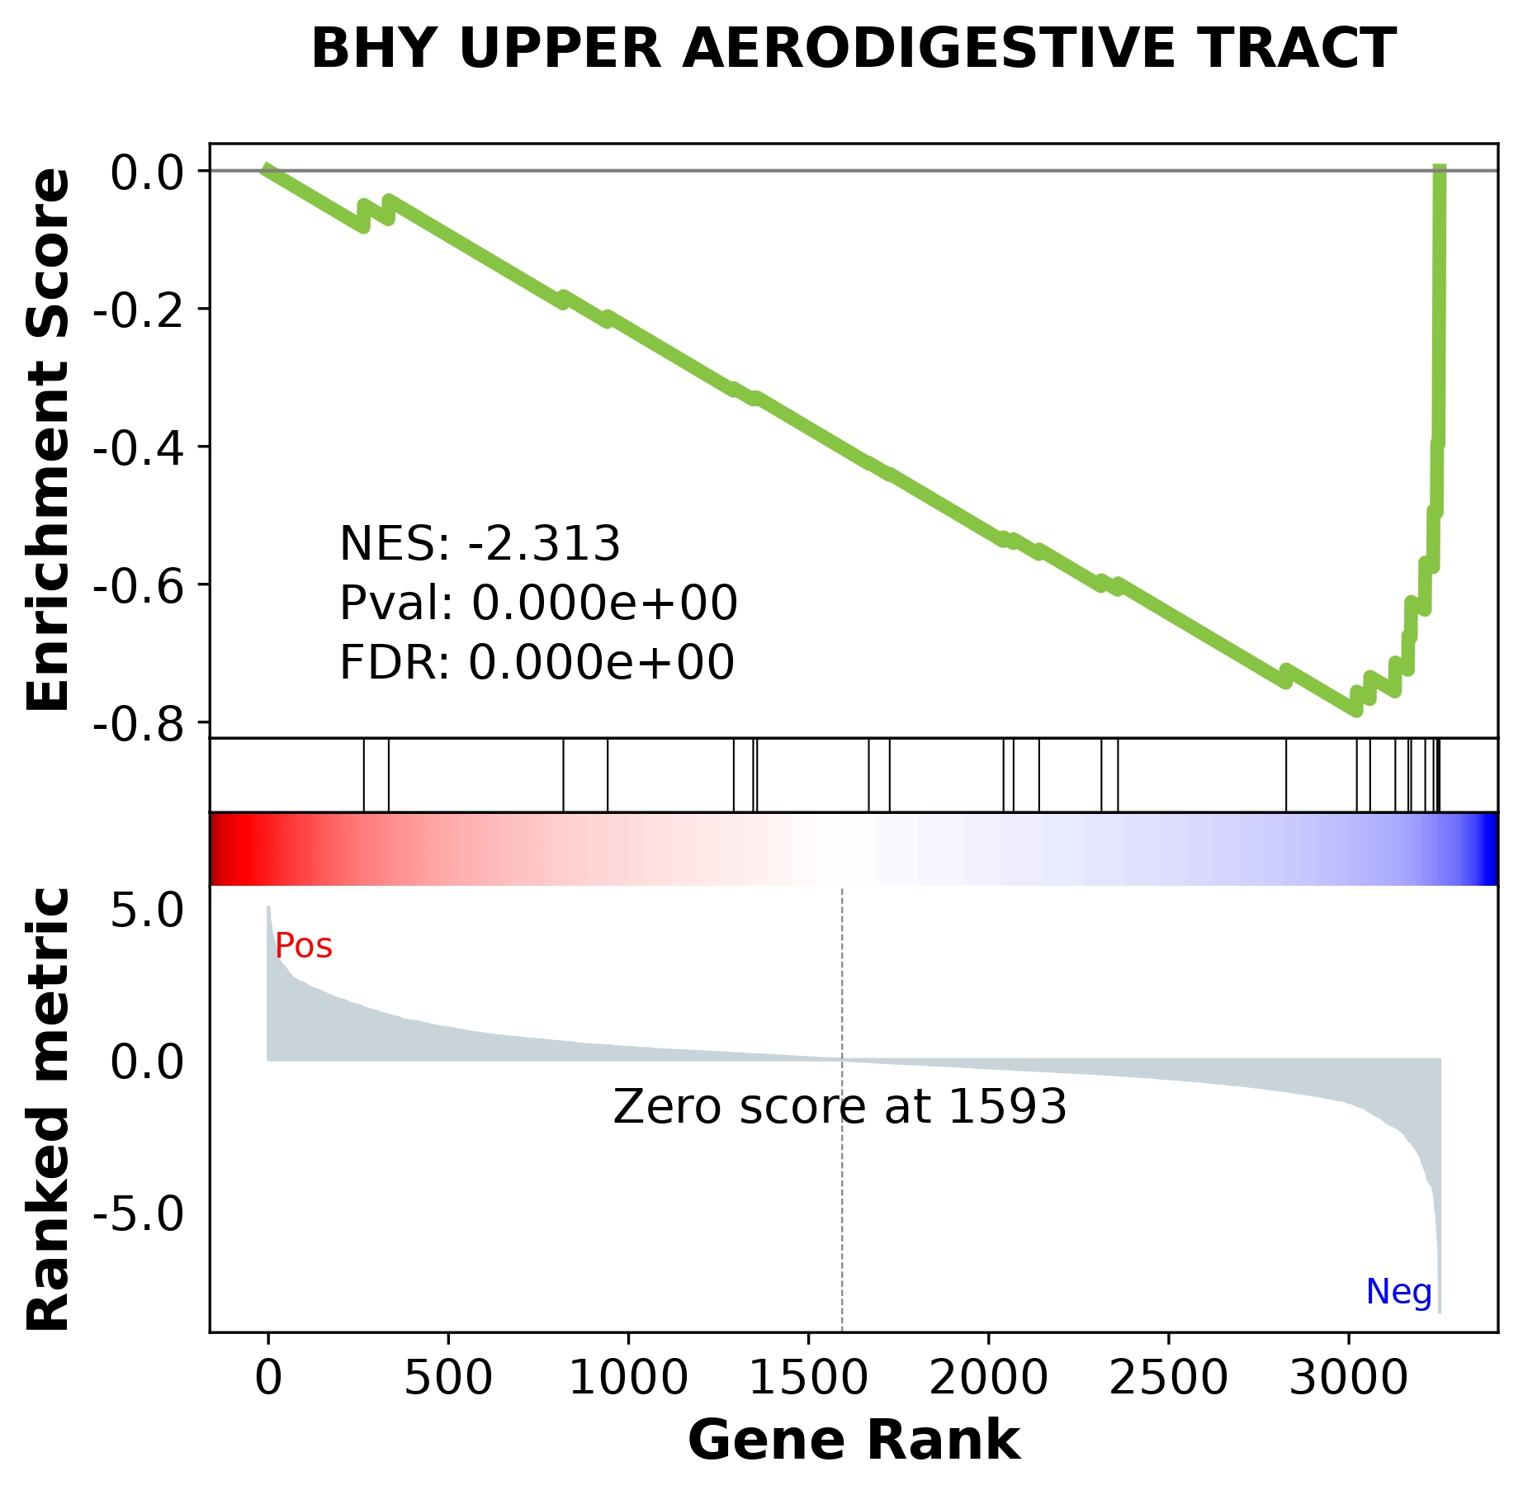
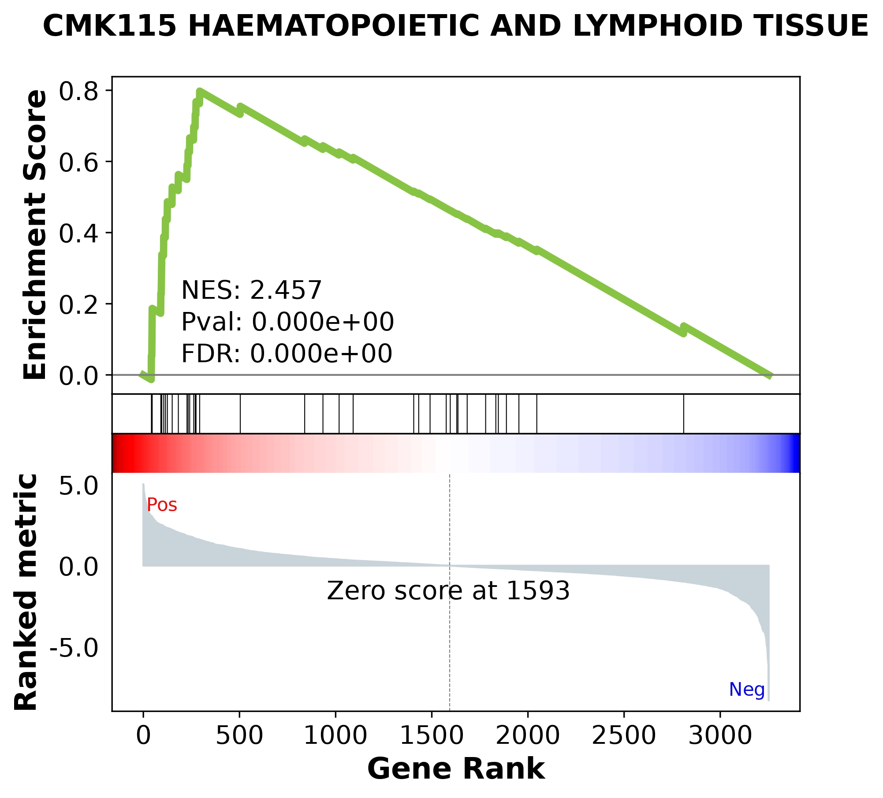

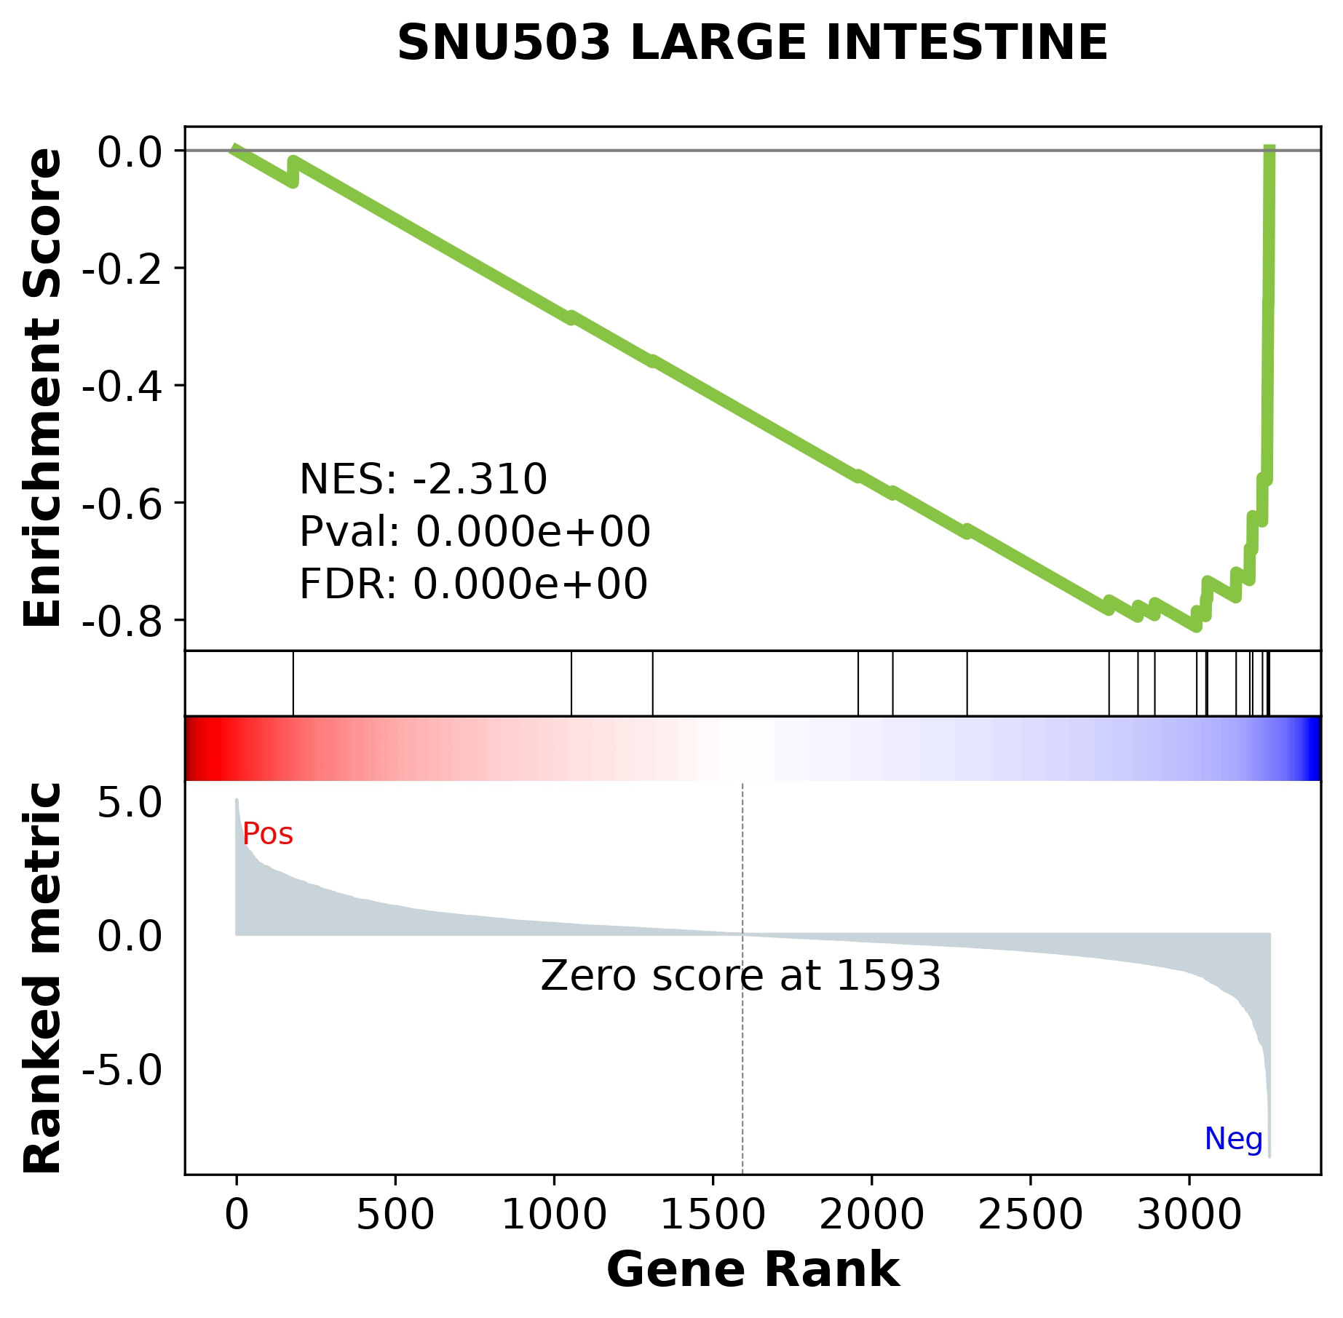
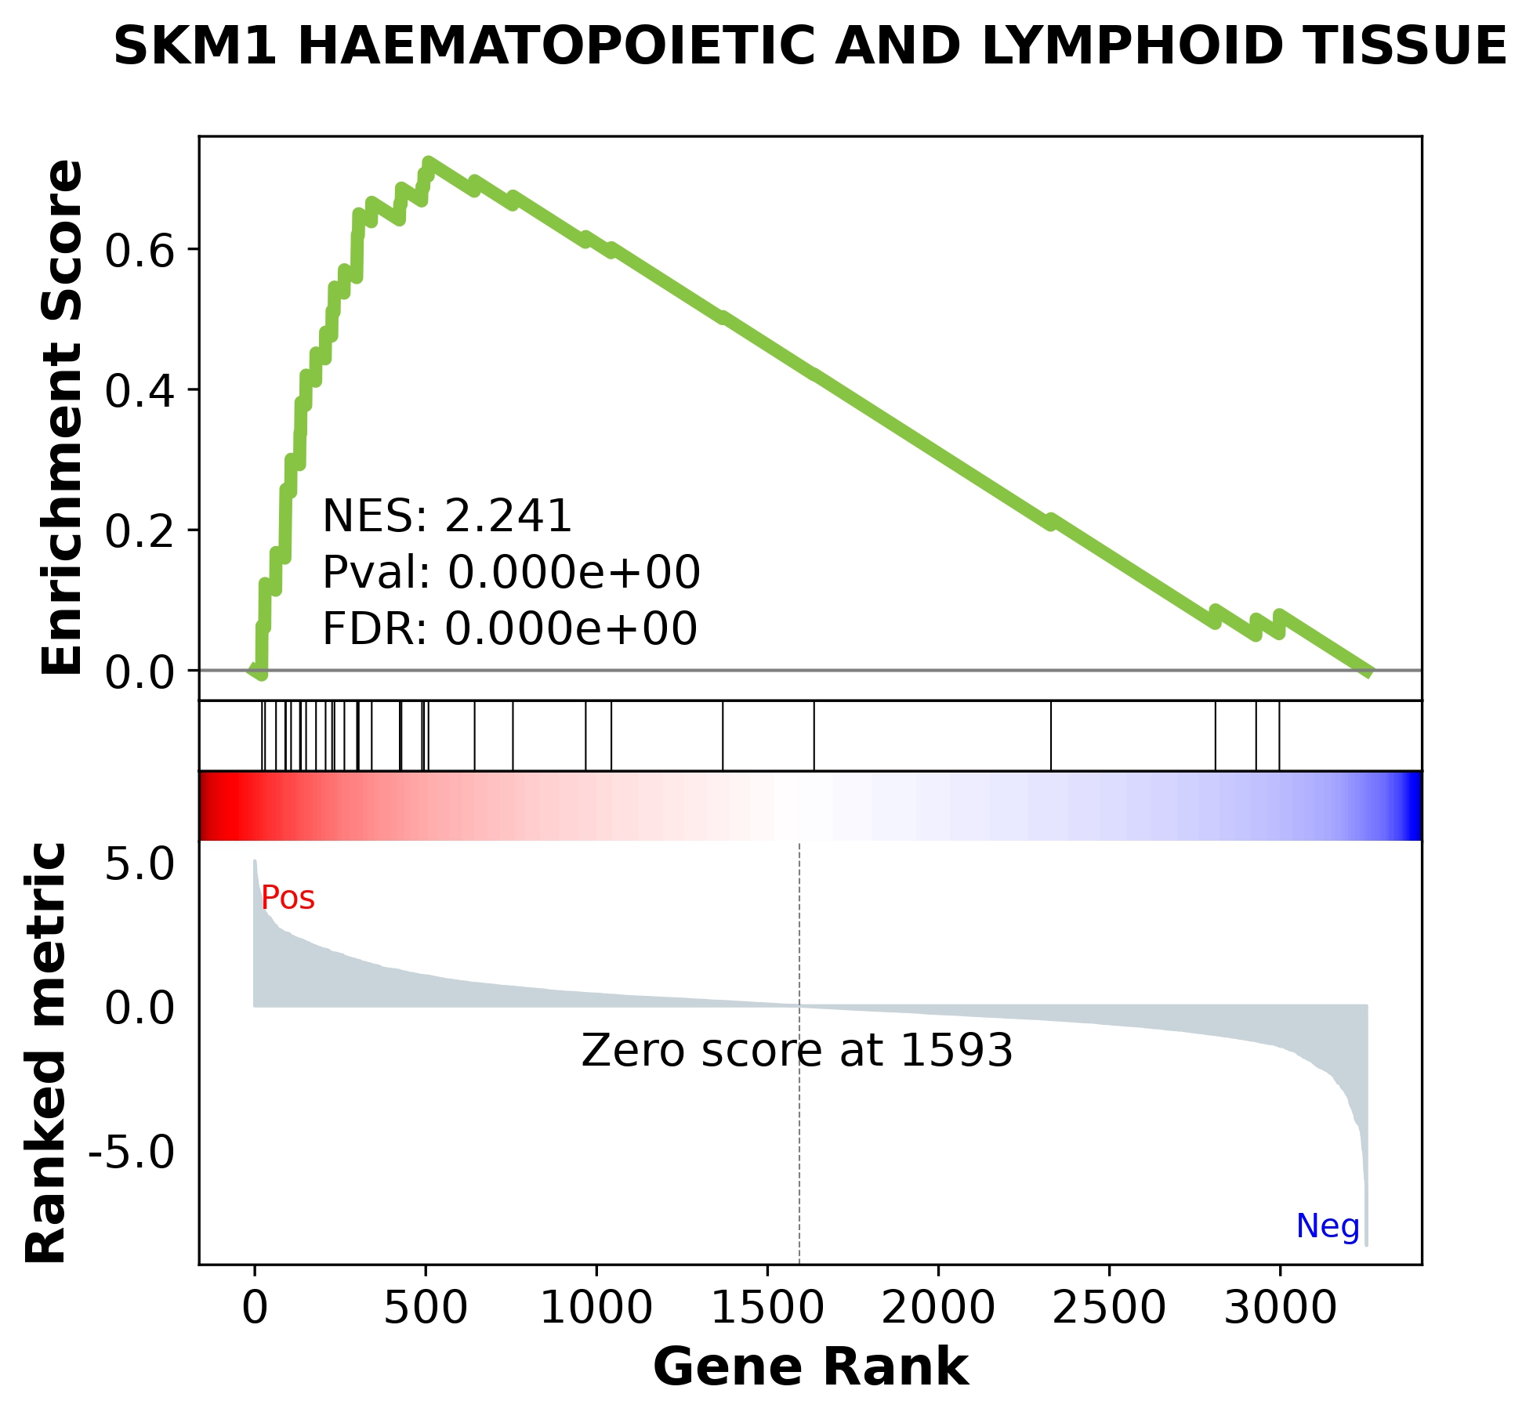
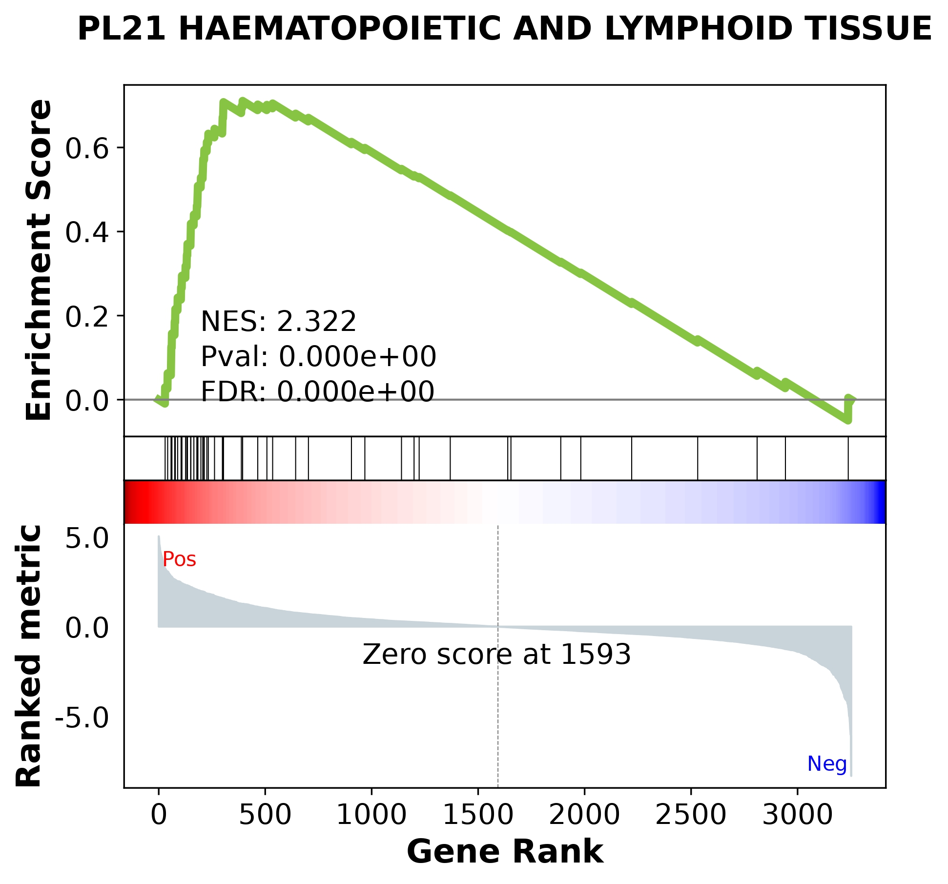

Slide 17
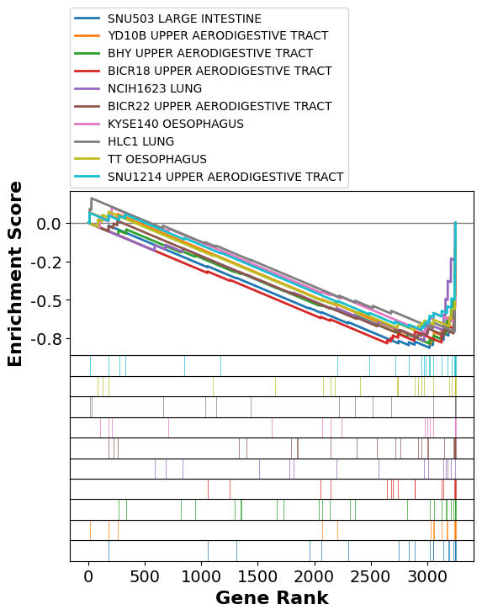
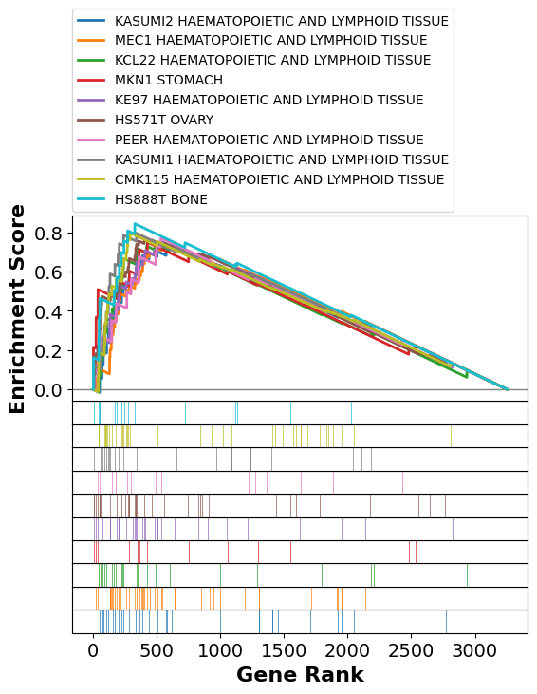

Slide 18
Discussion
The study effectively identifies differentially expressed genes in LUSC, leveraging both statistical tests and fold change analysis. Differences observed between the paired and independent sample hypothesis underline the impact of sample treatment on results. The volcano plot provided a clear visual representation, while GSEA furthered our understanding by integrating DEGs with biological pathways.

Slide 19
Thanks!
Thanks!
Thanks!
Mohamed Ibrahim
Mahmoud Magdy
Mahmoud Mohammed
Omar Abdelnasser

